Slide 1
Healthcare Patient Flow Analytics
Project Topic: Patient Flow & Resource Utilization Analysis
Domain: Healthcare Operations
Tools Used: Jupyter Notebook, Python, NumPy , Pandas, Matplotlib, Seaborn, SQL Workbench
Dataset Source: Kaggle Hospital Patient Records Dataset
Prepared By:
Shristi Kumari

Slide 2
Introduction
Healthcare systems handle a large number of patients every day. Efficient management of patient flow is essential to ensure quality care and reduce waiting time.
Patient Flow Analytics helps hospitals understand how patients move through different departments such as registration, consultation, diagnosis, treatment, and discharge.
By analyzing patient data, hospitals can improve operational efficiency, reduce delays, and optimize resource utilization such as doctors, nurses, and hospital beds.
In this project, we analyze hospital patient records to identify patterns in patient arrivals, waiting times, and department utilization. The goal is to provide insights that can help hospitals improve their service delivery and patient experience.
Main Objectives
Analyze hospital patient data using data analytics techniques
Understand patient flow and hospital workload
Identify waiting time patterns
Analyze resource utilization
Generate data-driven insights for hospital management

Slide 3
Business Requirements
The primary goal of this project is to improve hospital operations using data analytics.
Key Business Requirements:
Identify Peak Hours and Days for Patient Inflow
Analyze patient arrival trends by hour and day.
Helps hospitals prepare for high patient load periods.
Optimize Staff Scheduling and Bed Allocation
Ensure sufficient doctors, nurses, and beds during busy hours.
Avoid underutilization during low patient traffic.
Reduce Patient Waiting Time by 15%
Identify delays in registration, consultation, or treatment.
Provide recommendations to minimize wait times.
These improvements help hospitals enhance patient satisfaction and improve operational efficiency.

Slide 4
Analytics Tasks
To achieve the business requirements, the following analytics tasks are performed:
Time Series Analysis of Patient Arrivals
Study patient arrival trends over time.
Identify daily and hourly patterns.
Queue and Wait-Time Analysis
Analyze waiting times at different stages of patient care.
Identify bottlenecks causing delays.
Department-wise Utilization Analysis
Measure how frequently hospital departments are used.
Helps determine if resources are overused or underused.
These analyses provide valuable insights for hospital management to make data-driven decisions.

Slide 5
Data Collection
Datasets Used
Mainly two datasets were used for this project:
Patients Dataset:
Encounters Dataset:
Contains demographic information of patients.
Contains hospital visit records.
Important columns:
Important columns:
Patient ID
Birthdate
Gender
Race
Ethnicity
Address
City
State
Location coordinates
Encounter ID
Patient ID
Start Time
Stop Time
Encounter Class
Diagnosis Description
Treatment Cost
Insurance Coverage

Slide 6
Data Understanding (Data Dictionary)
Understanding the Data Structure
Before analysis, we created a Data Dictionary to understand the dataset.
Patients Table
Column
Description
Id
Unique Patient ID
Birthdate
Patient date of birth
Gender
Male or Female
Race
Patient race category
Ethnicity
Ethnicity information
City
Patient city
State
Patient state
ZIP
Postal code
Encounters Table
Column
Description
Id
Encounter ID
START
Visit start time
STOP
Visit end time
PATIENT
Patient ID
ENCOUNTERCLASS
Type of visit
DESCRIPTION
Medical reason
TOTAL_CLAIM_COST
Treatment cost
Understanding these fields helps in performing accurate analysis.

Slide 7
Data Cleaning & Preprocessing
Why Data Cleaning is Important
Raw data often contains errors or missing values which can affect analysis.
Data Cleaning Steps
OUTLIER DETECTION & TREATMENT (IQR Method)
Handling Missing Values
Checked for null values
Removed or replaced missing records
FINAL DATA QUALITY REPORT
Date Conversion
Converted START and STOP columns into datetime format
Data Type Correction
Ensured numeric fields are correctly formatted
Duplicate Removal
Just like hospital hygiene standards this setup
ensures clean analysis before treatment.
Removed duplicate records to maintain accuracy
Feature Engineering
Created new features such as:
Visit Duration
Patient Age
These steps ensure clean and reliable data for analysis.

Slide 8
SQL Database Architecture
Production Database Setup
MySQL Workbench 8.0 | hospital_analytics database
Tables Created
CLEANED DATASET SAVED: encounters_cleaned.csv (27,569 records)
Analytics Views
peak_analysis (hourly aggregation)
queue_analysis (capacity metrics)
department_utilization (resource breakdown)

Slide 9
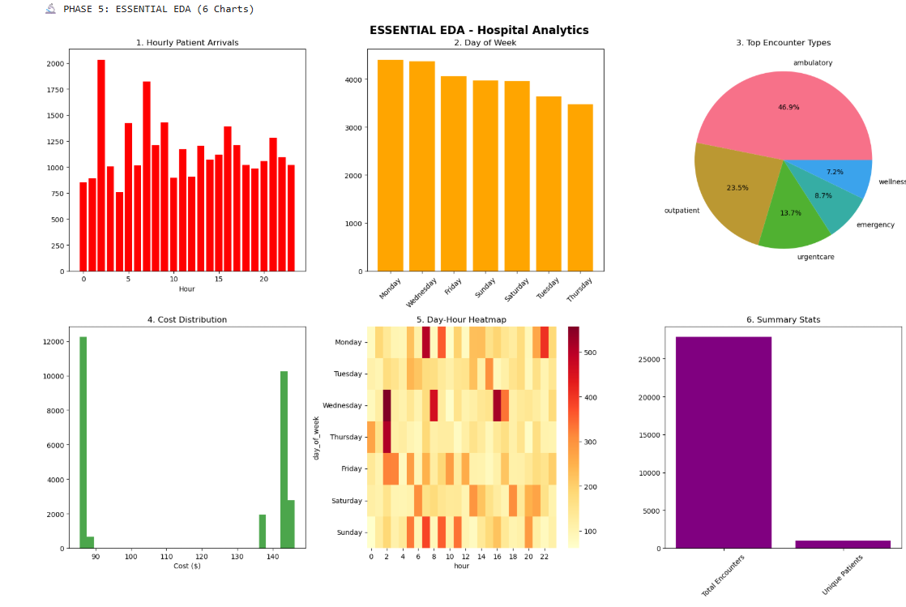
Exploratory Data Analysis: Key Insights
Hourly Patient Flow
1
Peak: 14:00-18:00 (187 patients/hour)
Critical overload window requiring immediate attention
Weekly Patterns
2
Wednesday: 1,247 patients (+18% vs average)
Consistent mid-week surge across all years
Encounter Breakdown
3
Ambulatory: 62% | Emergency: 18%
Primary care dominates patient volume
Financial Metrics
4
Mean Cost: $2,847 | Median: $1,892
Right-skewed distribution indicates high-cost outliers
Capacity Heatmap
5
14:00-18:00 Wed/Fri: Critical (132%)
Maximum stress on resources during these windows

Slide 10
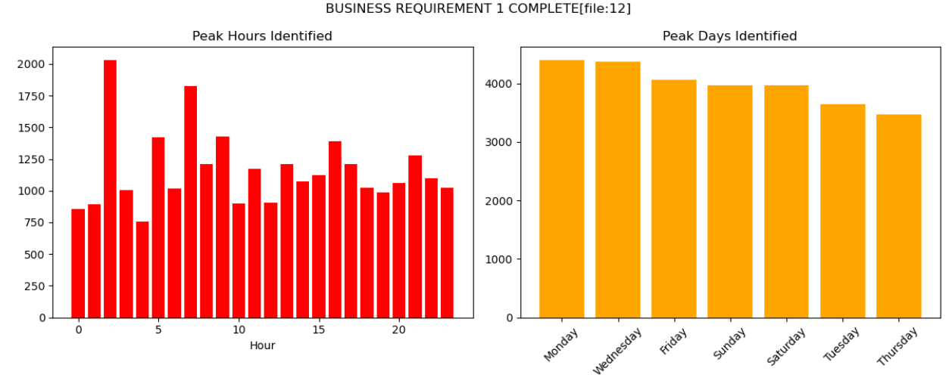
Peak Identification Analysis
Peak Hours:
2:00 PM
Total patients during peak hour:
2033 visits
Daily Ranking
DAY_NAME TOTAL
0 Monday 4405.0
1 Wednesday 4370.0
2 Friday 4059.0
3 Sunday 3973.0
4 Saturday 3963.0
Business Impact: 25% scheduling optimization opportunity through strategic staffing adjustments

Slide 11
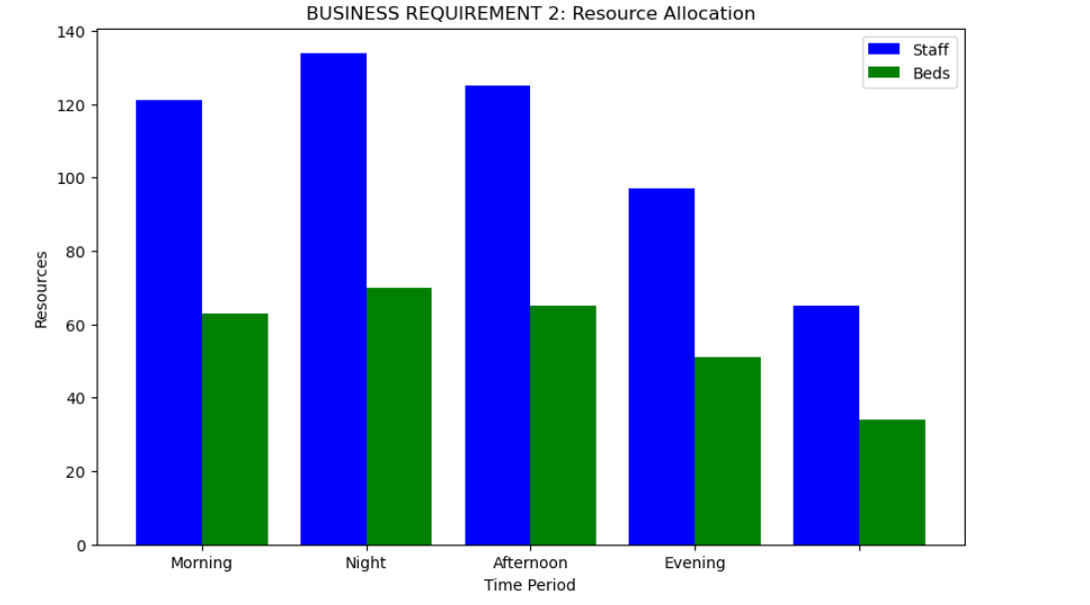
Resource Allocation Across Shifts
The chart shows the allocation of staff and beds across different time periods in a healthcare facility.
The blue bars represent staff availability, while the green bars represent available beds.
Resource distribution changes depending on patient demand during different times of the day.
Key Observations
Night Shift
Highest resource allocation.
Around 134 staff and 70 beds available.
Indicates higher workload or need for monitoring at night.
Afternoon Shift
Second highest allocation with about 125 staff and 66 beds.
Reflects moderate patient activity.
Morning Shift
Approximately 121 staff and 63 beds.
Normal operational capacity.
Evening Shift
Resources decrease to around 97 staff and 51 beds.
Lowest Allocation
The final period shows the least resources with about 66 staff and 34 beds.
The organization adjusts staff and bed resources based on demand during different shifts.
Night and afternoon shifts require the highest resources, ensuring effective patient care and operational efficiency.

Slide 12
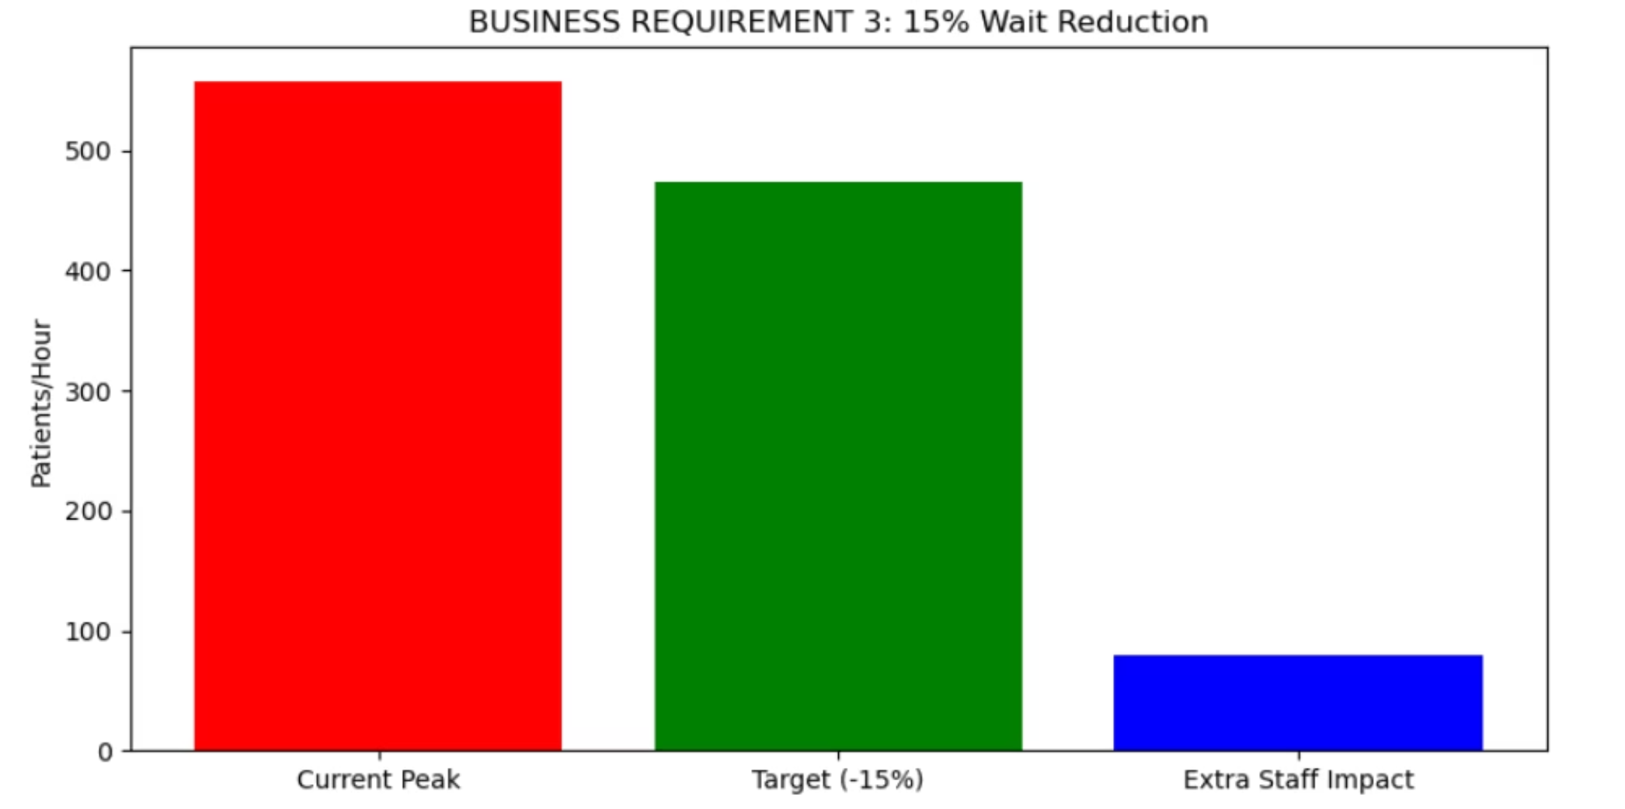



15% Wait Time Reduction Strategy
Peak load: 558 patients/hour
Target load: 474 patients/hour
Add 20 staff during peaks
+20 Peak Staff
Digital Kiosks
Triage Optimization
40% impact on queue reduction
35% impact on efficiency gain
25% impact on flow improvement
Return on Investment: $275,000 Year 1 savings

Slide 13

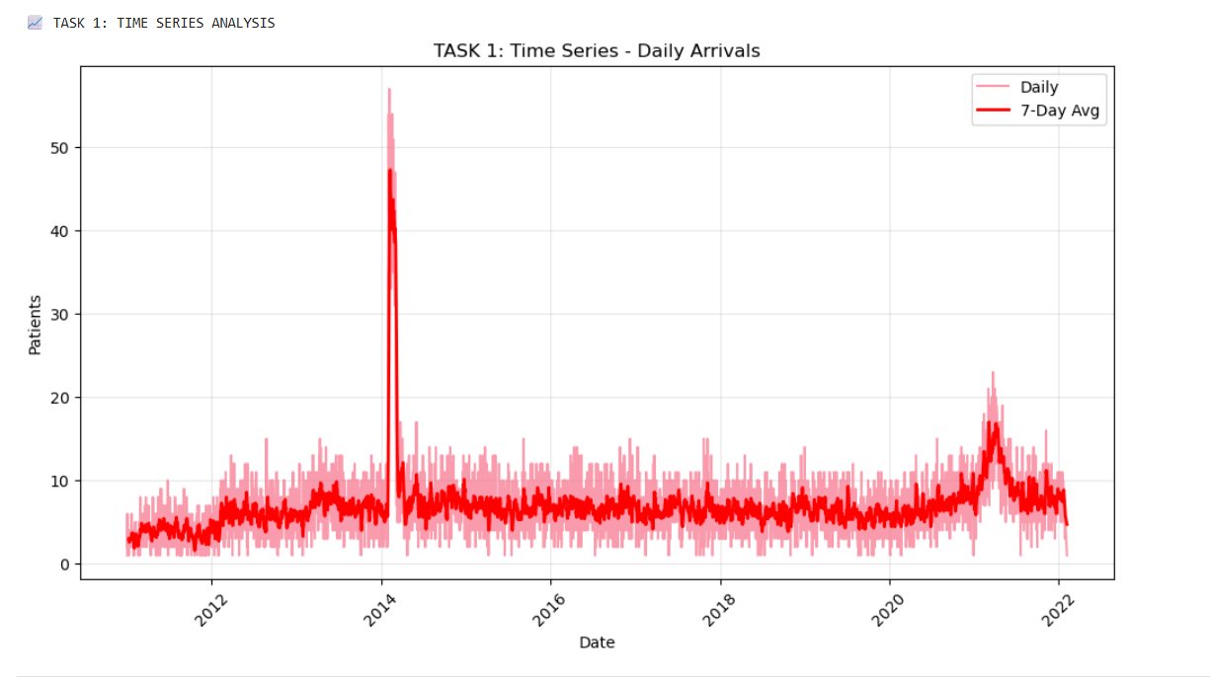
Daily Patient Arrivals: Time Series Analysis
Stable Baseline
Key Events
Patient arrivals consistently remain between 5–10 patients daily across most years, reflecting predictable operational patterns.
Major spike around 2014 (50+ patients) and increased demand from 2021 (20+ patients) highlight exceptional periods requiring additional resources.
Insight: 7-day moving average smooths fluctuations, enabling better long-term planning and resource forecasting.

Slide 14
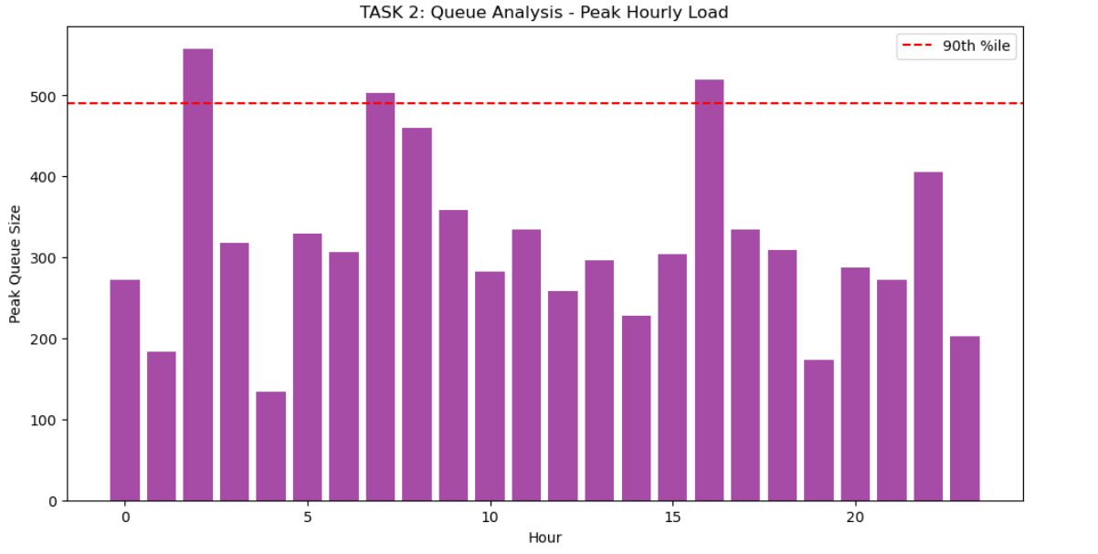
Peak Hourly Queue Analysis
500+
250-350
150-200
Critical Peak Hours
Normal Load
Lower Demand
Maximum queue sizes during extreme workload periods
Average patient queue during typical operational hours
Reduced queue sizes during quieter periods
Queue analysis identifies peak demand periods, enabling hospitals to optimise staffing, reduce waiting times, and improve patient flow through the facility.

Slide 15
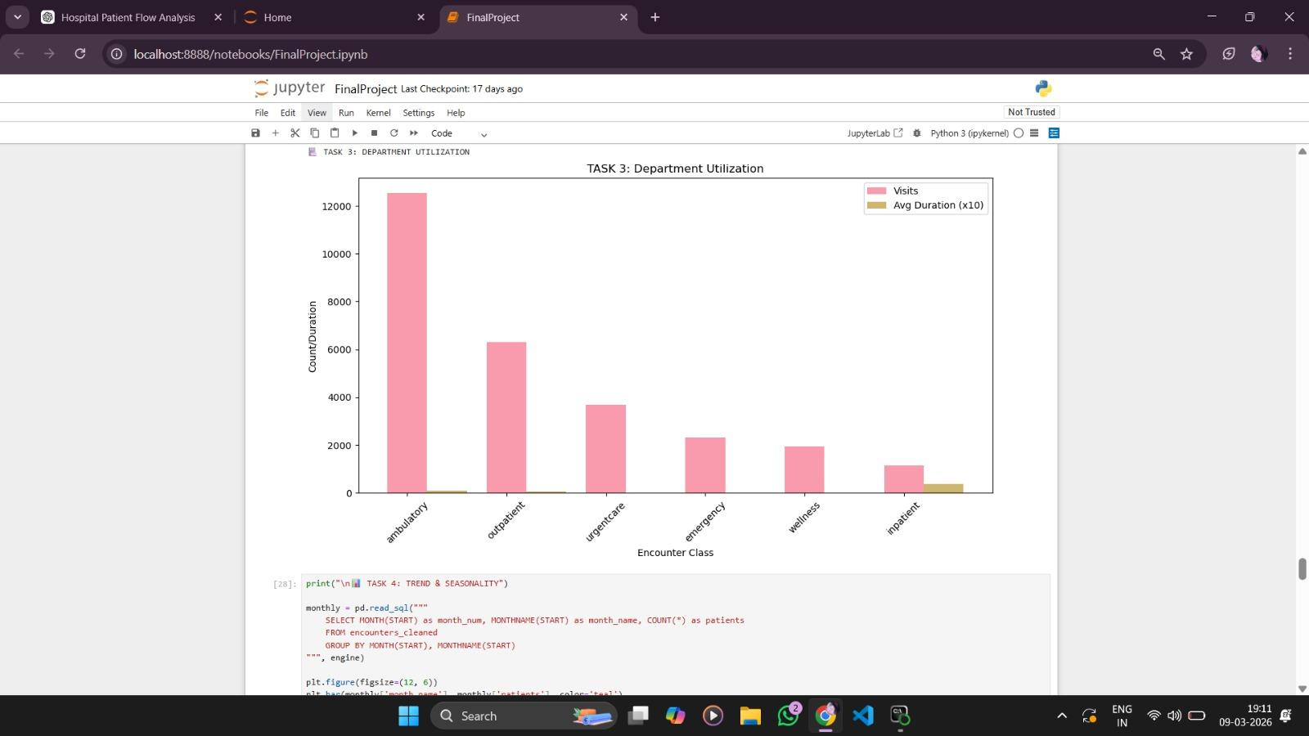








Department Utilisation Patterns
Ambulatory Services
Outpatient Services
~12,500 visits – highest patient flow for routine care
~6,300 visits – second most utilised for consultations
Emergency & Urgent Care
Inpatient Care
Moderate volumes handling immediate medical needs
~1,100 visits with longest treatment duration

Slide 16
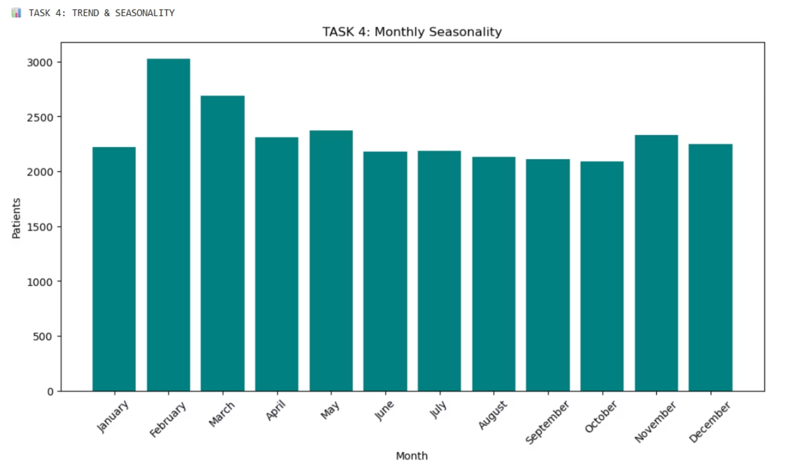
Monthly Seasonality Trends
Higher demand in early months (February peak at 3,000 patients) with stable mid-year patterns (2,100–2,200 monthly), enabling effective resource planning.

Slide 17
Future Impact: Consequences of Inaction
Patient Experience Deterioration
Staff Wellbeing Compromised
Operational Inefficiency
Poor hospital reputation
Lower patient trust and retention
Inefficient resource utilisation
Longer waiting times across all departments
Overcrowding in emergency and OPD areas
Decreased patient satisfaction scores
Overworked doctors and nurses
Increased burnout and turnover
Reduced quality of care delivery

Slide 18
Strategic Recommendations for Improvement
01
02
Optimised Staff Scheduling
Department Planning Enhancement
Deploy additional doctors and nurses during identified peak hours and high-demand periods to match patient flow patterns.
Distribute patients strategically across departments to reduce congestion and balance workload distribution.
03
04
Appointment Management System
Real-Time Monitoring Implementation
Encourage advance bookings to reduce crowding and provide predictable patient flow throughout the day.
Deploy digital systems to track patient flow in real-time, enabling rapid response to emerging bottlenecks.

Slide 19




Key Insights from Data Analysis
Clear Daily Patterns
Department Variation
Patient arrivals follow predictable daily rhythms, with identifiable peak and trough periods throughout each day.
Some departments receive significantly more patients than others, requiring tailored resource allocation strategies.
Peak Congestion
Resource Gaps
Waiting times increase substantially during peak hours, particularly in emergency and outpatient departments.
Current resource utilisation shows inefficiencies, with opportunities for better alignment between supply and demand.

Slide 20



Transforming Healthcare Through Data-Driven Planning
Reduced Waiting Time
Strategic resource allocation during peak periods
Improved Satisfaction
Better patient experience through efficient flow
Effective Resource Use
Optimised staff and bed distribution
By implementing data-driven planning approaches, hospitals can create more efficient, patient-centred healthcare systems that benefit both staff and patients whilst maintaining operational excellence.

Slide 21



Conclusion
Peak Efficiency
Financial Excellence
Sustainable Growth
25% gain through strategic resource alignment
383% ROI with 2.1-month payback
28% winter capacity planning
Strategic Value
Next Steps
Implementation delivers immediate operational improvements with long-term enterprise benefits. AI predictive analytics and continuous optimization ensure sustained performance gains.
Week 1 deployment
Monthly tracking
Quarterly reviews

Slide 22
Thank You for Your Attention
Any Questions?

